Slide 1


Slide 2

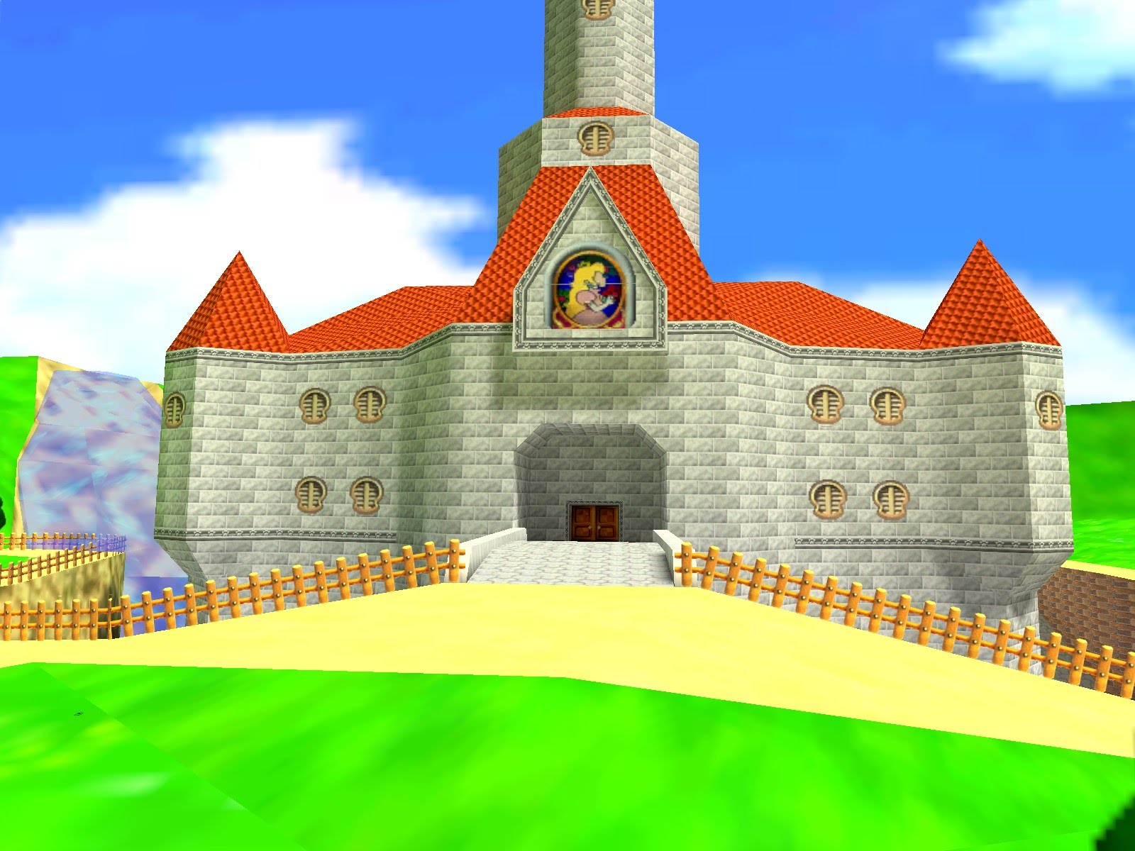

Overview of the Game
Mama mia its-a toad

Slide 3
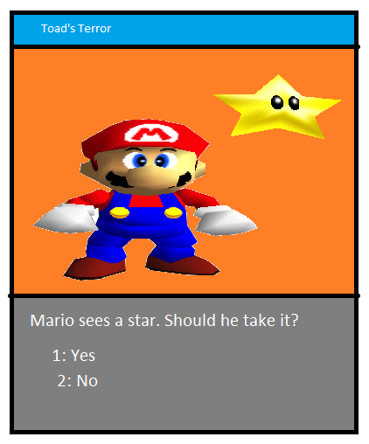
Overview of the Game
Image (maybe video clip?) relating to current story event
Text area, containing story, description of player’s surroundings and options.

Slide 4
Goals for the Game
1. Finish it!

Slide 5
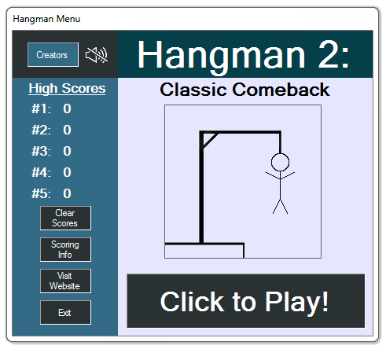
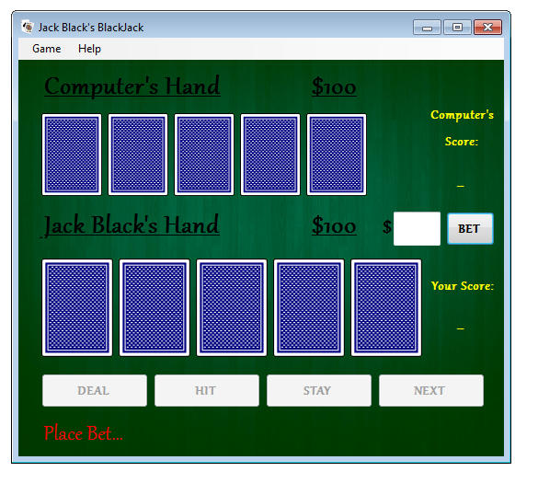
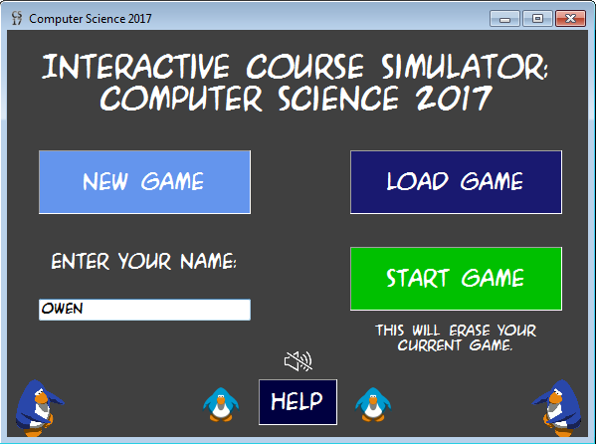
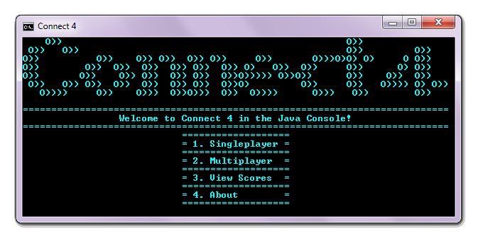
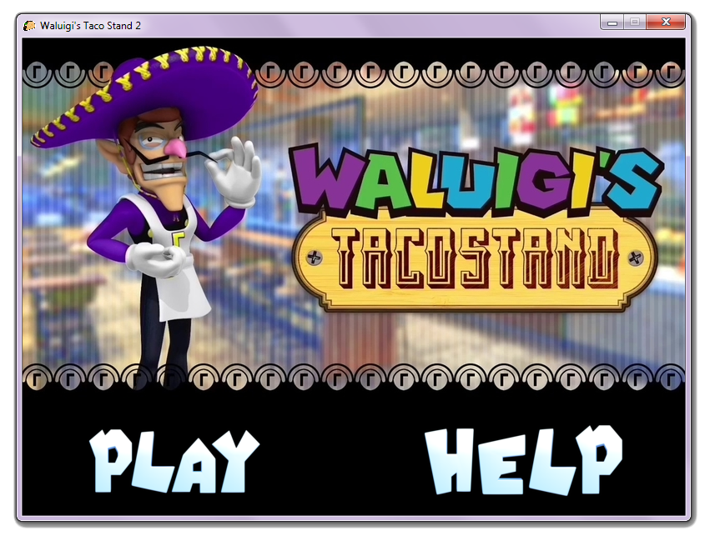
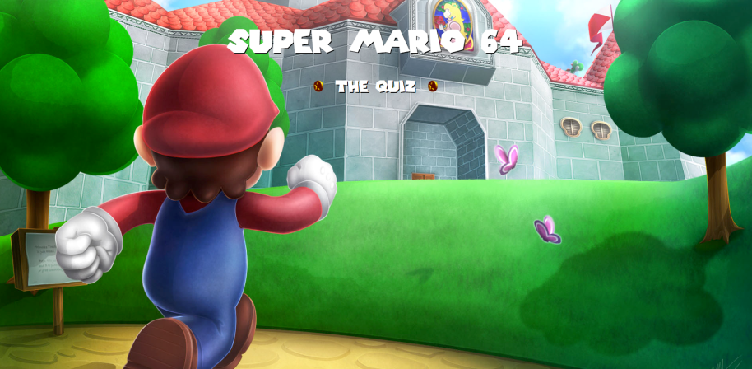
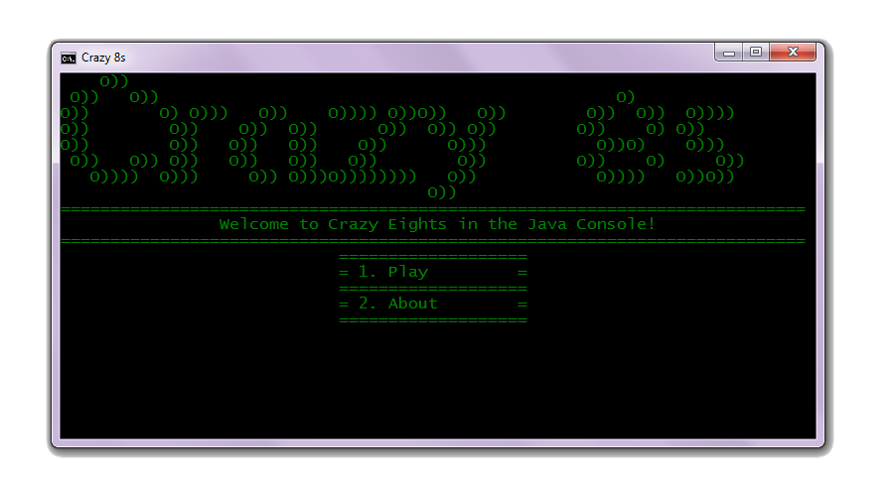
Goals for the Game
2. Best thing we’ve made so far!

Slide 6

Goals for the Game
3. Scary!

Slide 7
Concerns for the Game
1. Seems a little basic.
Can be drawn in Paint.

Slide 8

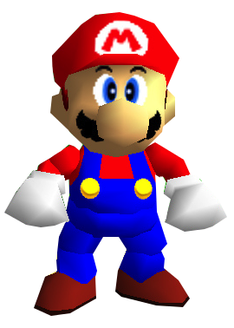
Concerns for the Game
2. Object Oriented Programming is evil
CLASS
OBJECT

Slide 9
Roles
Owen does most of the code, because he does it fast.
Owen: Lead Programmer

Slide 10
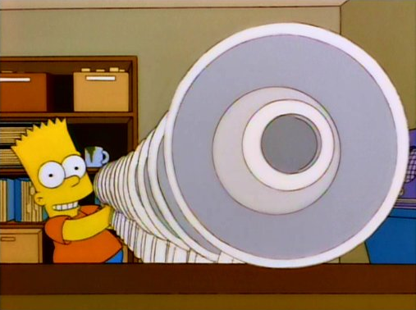
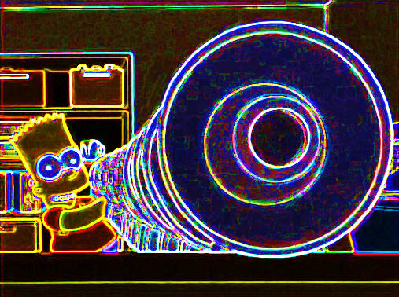
Roles
Kevin does cool stuff, like photoshopping images and creating audio.
Kevin
Kevin will also come up with most of the story.
Kevin: Lead Writer and Graphic Designer

Slide 11


